Slide 1
Employee Data Analysis using Excel
Tahaziya Tabassum
Chevalier T.Thomas Elizabeth college for women
B.com general
312209040

Slide 2
PROJECT TITLE
Employee Performance Analysis using Excel

Slide 3


AGENDA
Problem Statement
Project Overview
End Users
Our Solution and Proposition
Dataset Description
Modelling Approach
Results and Discussion
Conclusion
3/21/2024 Annual Review

Slide 4

PROBLEM STATEMENT
FOR IS ACHIEVEMENT
FOR IS INCREMENT
Effectively considers multiple perspectives and approaches before making decisions
Displayed a consistently strong ability to tackle challenging problems efficiently

Slide 5

PROJECT OVERVIEW
analyzing the performance of the employee by considering various factors like gender performance score ratings performance analysis in order to identify the Trends and patterns of different categories of employees like high medium low
Compare strengths and weaknesses. ...
Recommend actionable goals. ...
.

Slide 6

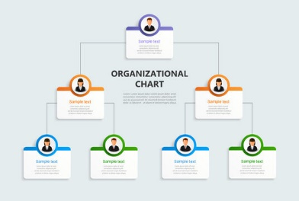

WHO ARE THE END USERS?

Slide 7

OUR SOLUTION AND ITS VALUE PROPOSITION
CONDITIONAL FORMATTING-MISSING
FILTER-REMOVE
FORMULA-PERFORMANCE
PIVOT-SUMMARY
GRAPH-DATA VISUALIZTION

Slide 8
Dataset Description
EMPLOYEE=-KAGGLE
26-FEATURES
9 FEATURES
EMP TYPE
PERFORMANCE LEVEL
GENDER-MALE FEMALE
EMPLOYEE RATING-NUM

Slide 9

THE "WOW" IN OUR SOLUTION
PERFORMANCE LEVEL =IFS(Z8>=5"VERY HIGH",Z8>=4"HIGH",Z8>=3,"MED",TRUE,"LOW")
3/21/2024 Annual Review
‹#›

Slide 10
MODELLING
DATA COLLECTION
GAGGLE TO DOWNLOAD THE DATA
FETURE COLLECTION
Employee Status
Employee Type
Gender Code
Performance Score
Current Employee Rating
DATA CLEANING
MIISSING VALUE IDENTIFY
MISSING VALUE FILTER
PERFORMANCE LEVEL
SUMMARY
CREATE A PIVOT TABLE
CREATING GRAPH
‹#›

Slide 11
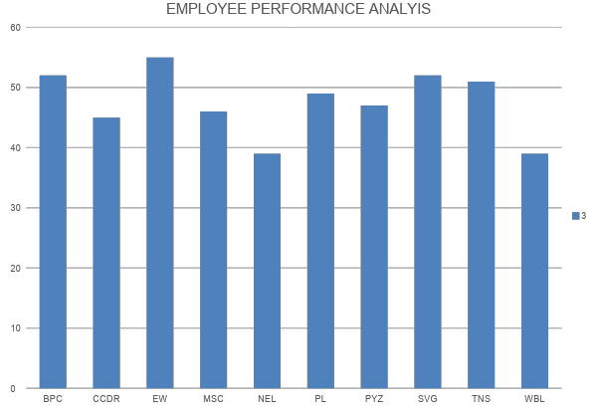
RESULTS
‹#›

Slide 12
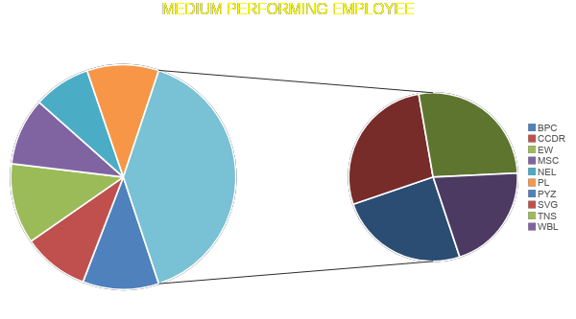
RESULTS

Slide 13
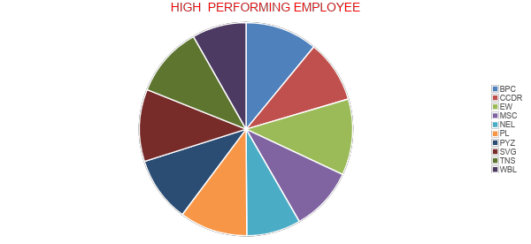
RESULTS

Slide 14
conclusion
By comparing the performance of the employees the number of employees are higher in number average performance by employee by giving them different levels of task based on their performance and the work……. we need to motivate them for the better outcome….

